Slide 1

3D GEOLOGICAL CONCEPTUAL GROUNDWATER MODELLING USING GMS
BTech CV449 - Major Project – I Presentation
Presented By:
Kandolu Vasantha Raju (221CV225)
Gowtham R (221CV222)
Under the guidance of: Dr. Dwarakish G S Dept. Water Resource & Ocean Engineering
NITK Surathkal
DEPARTMENT OF WATER RESOURCES & OCEAN ENGINEERING NATIONAL INSTITUTE OF TECHNOLOGY KARNATAKA, SURATHKAL
MANGALURU-575025
1

Slide 2
CONTENT :
INTRODUCTION
LITERATURE REVIEW
OBJECTIVES
STUDY AREA
METHODOLOGY
RESULTS AND CONCLUSION
REFERENCES
2

Slide 3
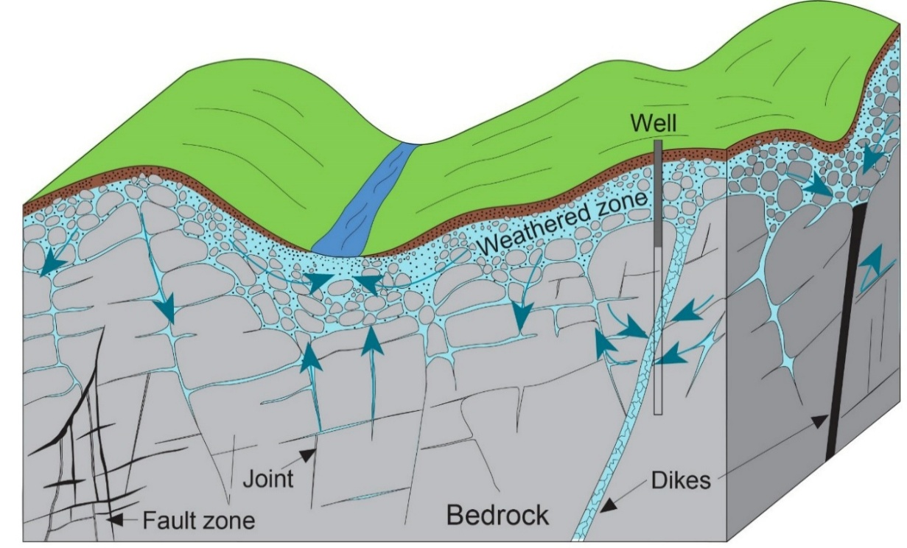
INTRODUCTION :
Groundwater is the most reliable water source in semi-arid regions
Groundwater occurs mainly in fractures and weathered hard-rock zones
Agriculture depends heavily on groundwater for year-round irrigation
Over-extraction + low recharge are causing rapid groundwater decline
Hard-rock aquifers store water only in fractures, not continuous layers
3D conceptual modelling is needed to understand fracture-controlled aquifers
Source: *Modified from Freeze and Cherry, 1979
4

Slide 4

LITERATURE REVIEW :
Author | Title | Year of Publication | Key Conclusion
Marechal et al. (2020) | Structure of Hard-Rock Aquifers | 2020 | Groundwater stored mainly in fractures Three-layer aquifer system identified Flow controlled by fracture geometry
Dewandel et al. | Fracture Distribution in Crystalline Rocks | 2012 | Vertical fractures control transmissivity Productivity increases with fracture depth Hard-rock systems highly heterogeneous
Central Ground Water Board | Groundwater Resources of Chamarajanagar–Mysuru Region | 2012 | Low-storage crystalline aquifers dominate Rapid decline under heavy pumping Recharge limited in hard-rock areas
5

Slide 5
LITERATURE REVIEW :
Author | Title | Year of Publication | Key Conclusion
Atal Bhujal Yojana | Hydrogeology Assessment – Karnataka | 2023 | Hard-rock zones show stressed levels Borewell dependence increasing yearly Recharge structures urgently required
Various (IISc / International studies) | Fracture Connectivity in Crystalline Terrains | 2015–2020 | Fracture continuity controls yields Deep fractures often isolated Geometry essential for modelling
6
6

Slide 6
OBJECTIVES :
Understand groundwater importance, depletion, and hydrogeology in the semi-arid Gundlu Basin
Support sustainable drilling, recharge, and water-use planning through scientific modelling
Develop a 3D conceptual groundwater model using GMS for mapping subsurface layers and guiding sustainable management
7

Slide 7
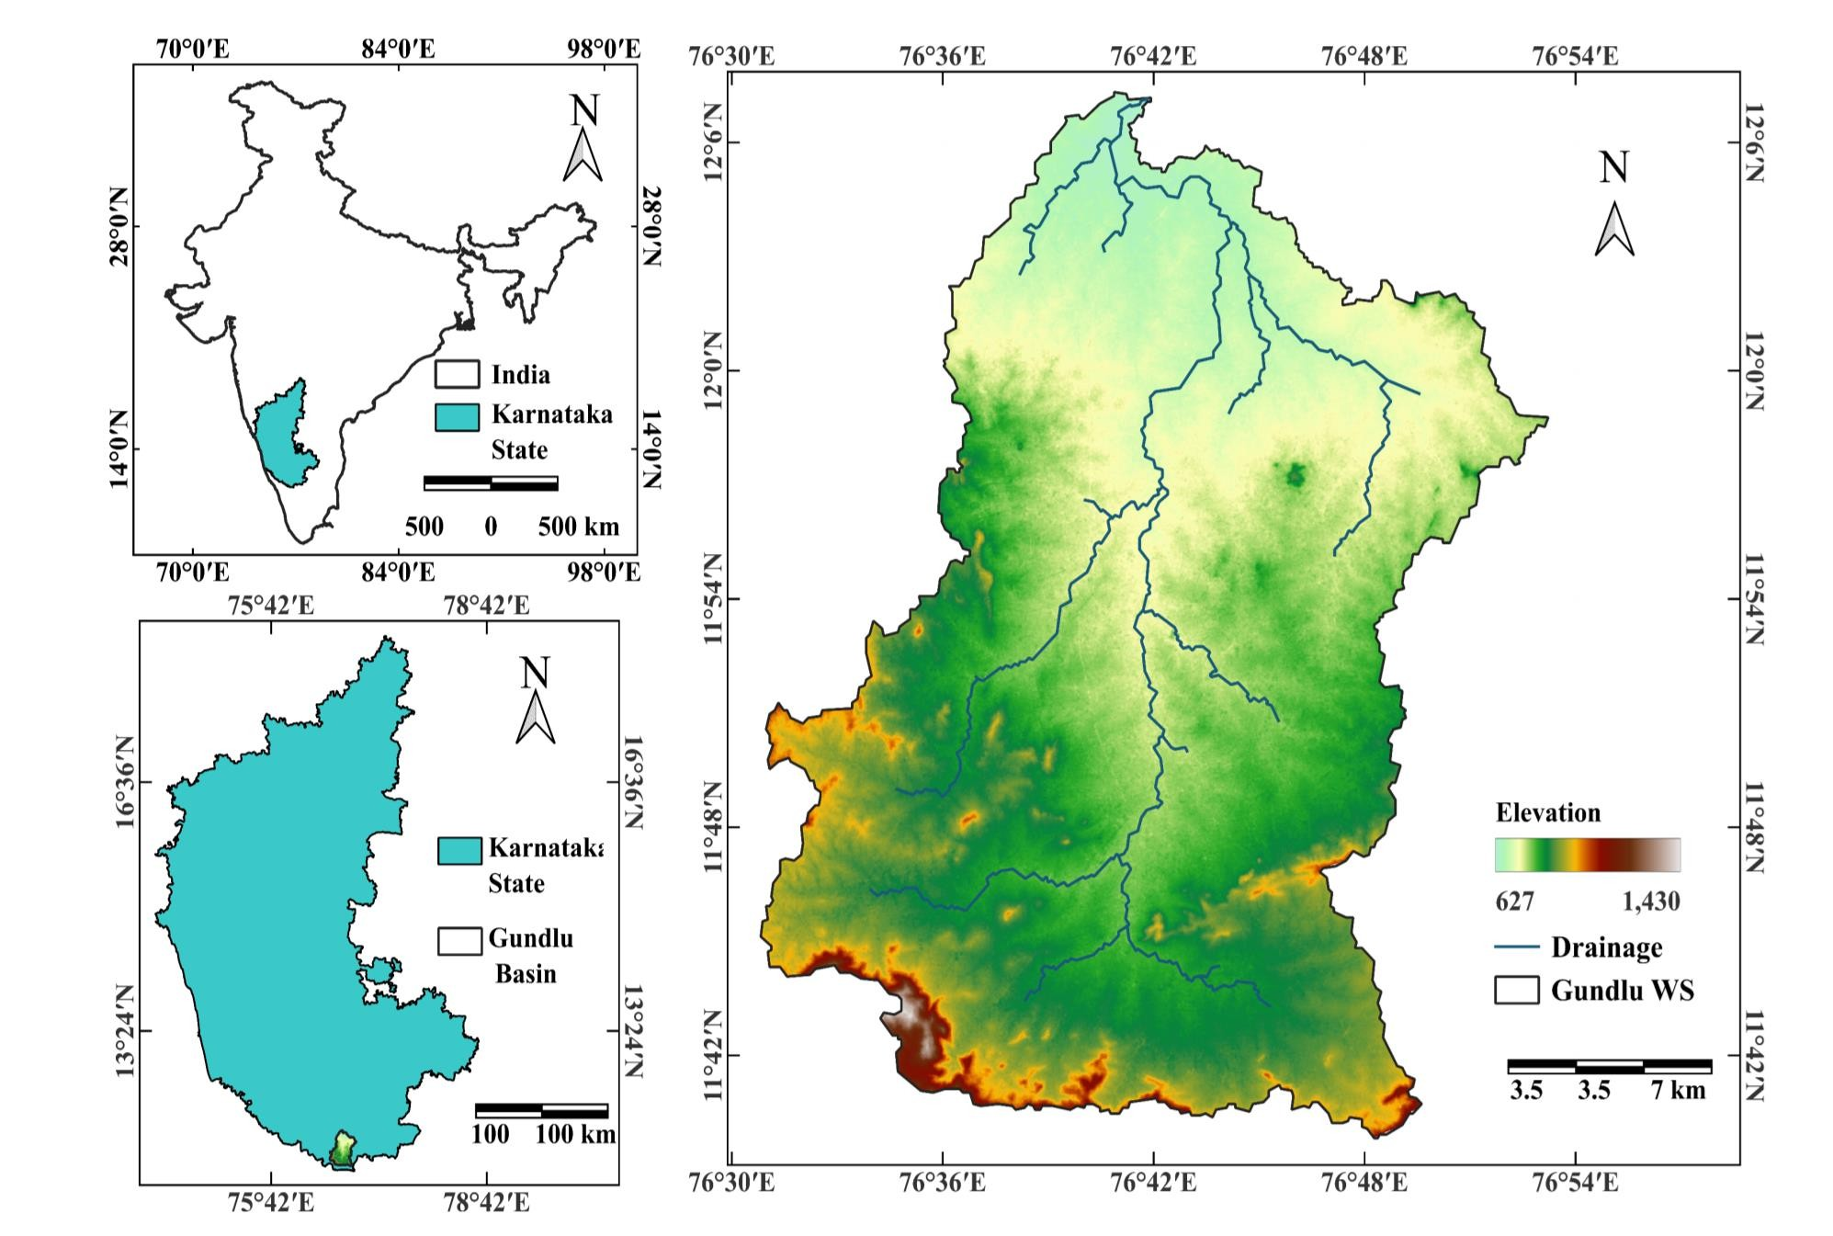
STUDY AREA MAP:
Gundlu Sub-Basin
Tributary of Kabini River
Basin Area : 1,270 km²
Annual Average Rainfall (~600 mm)
Semi-Arid region
Irrigation – Rainfall and groundwater
Significant decline in groundwater levels
8

Slide 8
DATA SETS :
SI.No | Data / Parameter | Source / Agency | Resolution / Scale
1 | Borewell Locations (Lat/Long) | Local Borewell Drillers | Point data
2 | Casing Pipe Elevation (CP) | Local Borewell Drillers | Borehole-specific (meter depth)
3 | First Fracture Depth (FWD) | Local Borewell Drillers | 20–40 m (typical range)
4 | Second Fracture Depth (SWD) | Local Borewell Drillers | 50–80 m (typical range)
5 | Shapefile – Basin Boundary | GIS / Govt. Database | Vector
6 | Digital Elevation Model (DEM) | Remote Sensing (SRTM/ASTER) | 30 m or 12.5 m resolution
9

Slide 9
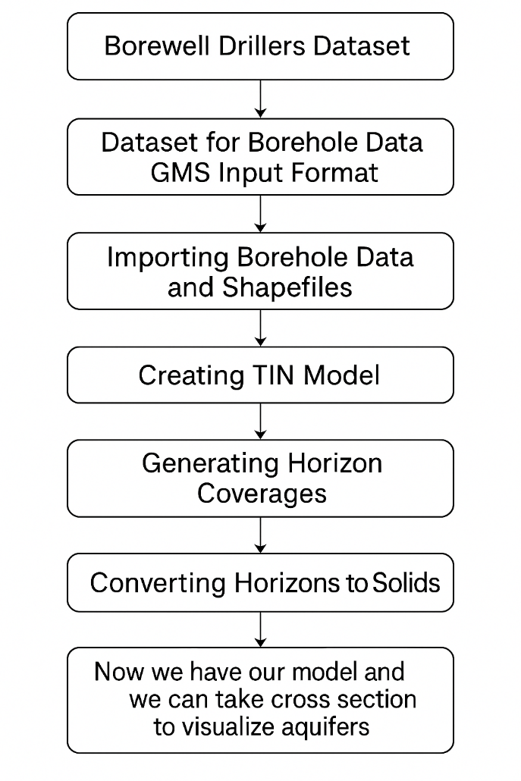
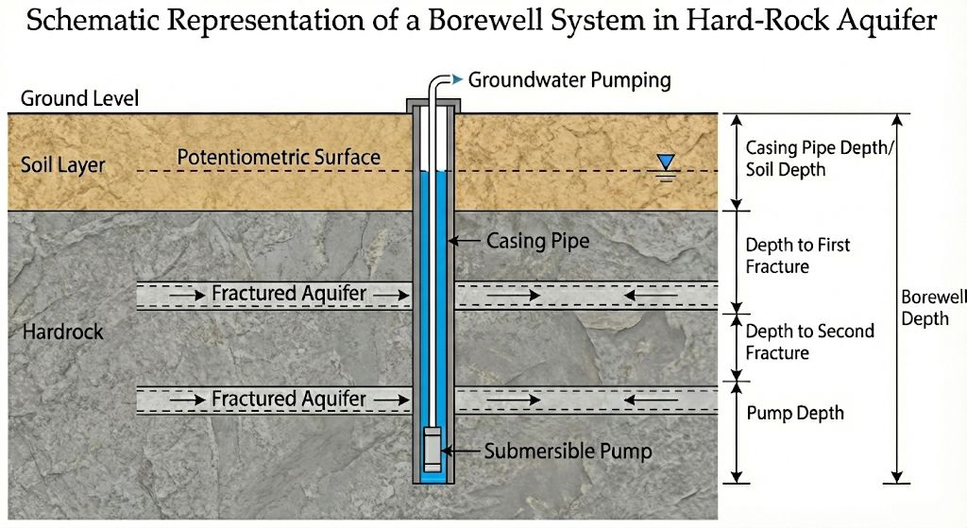
METHODOLOGY :
11

Slide 10
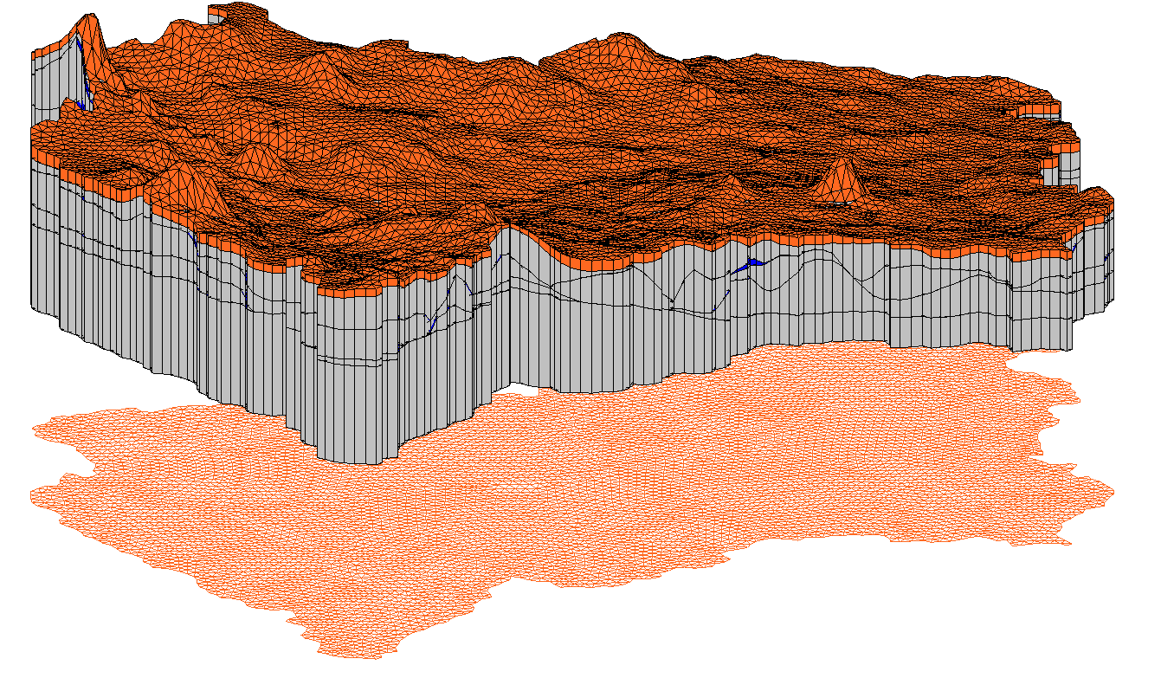
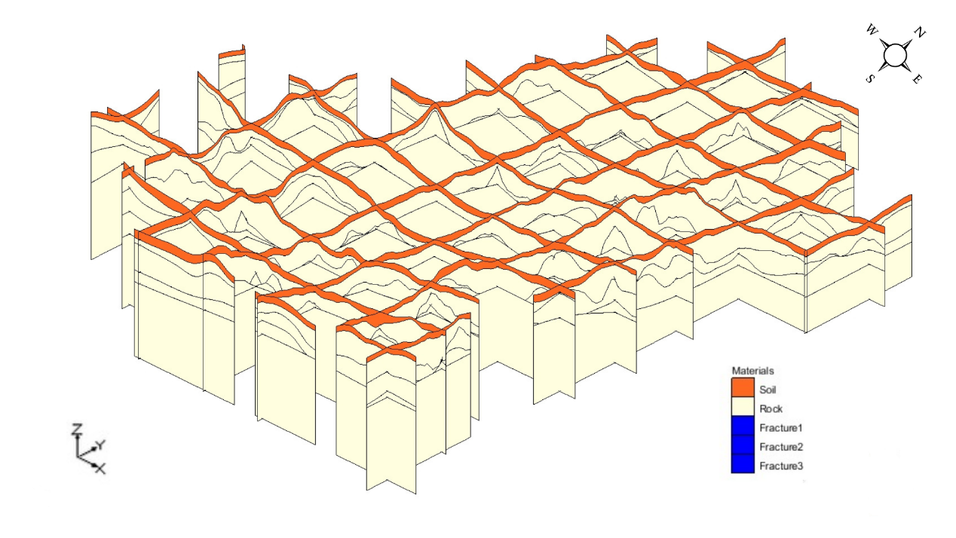
RESULTS AND DISCUSSION :
3D Geological conceptual Modelling
Fence Diagram
14

Slide 11
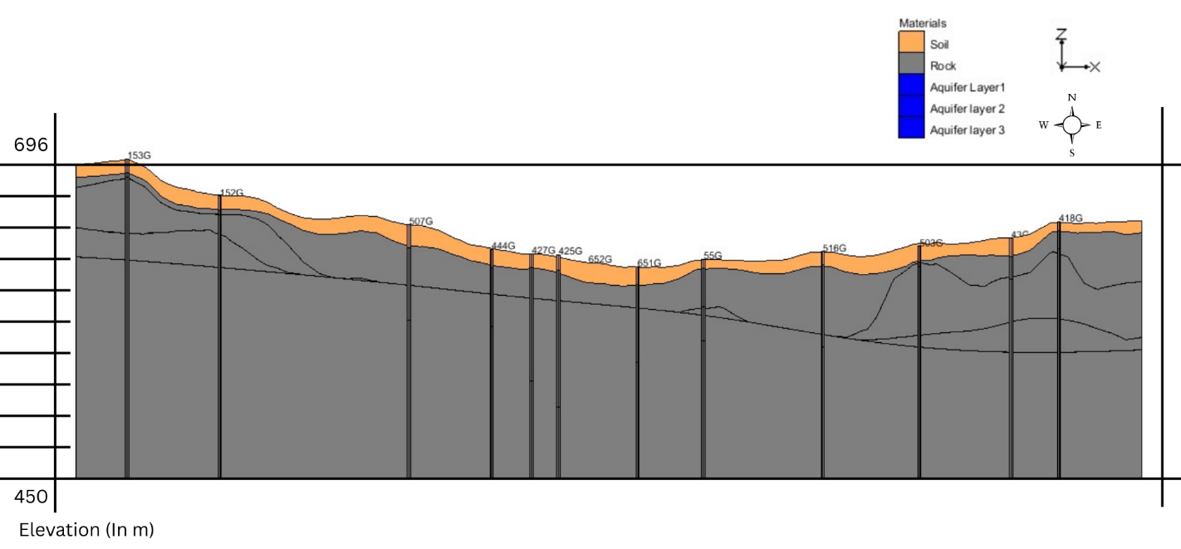
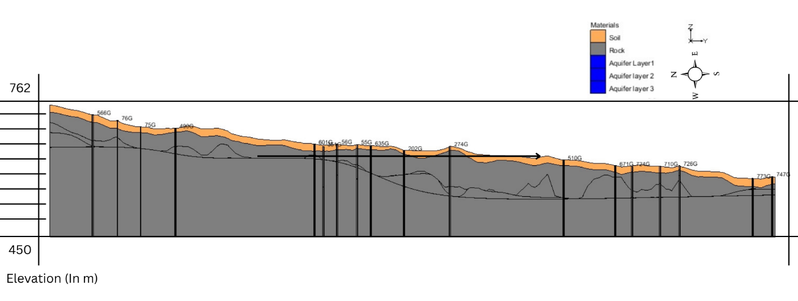
RESULTS AND DISCUSSION :
Horizontal Cross Section
Vertical Cross Section
15

Slide 12
RESULTS AND DISCUSSION :
Groundwater occurs mainly in fracture zones; massive rock stores almost no water.
Productive wells intersect multiple fractures, while single-fracture wells show low yield.
Deep fractures (90–120+ m) are isolated pockets, forming the highest-yield aquifer zones.
3D model, fence diagrams, and cross-sections clearly map fracture geometry, revealing true
groundwater potential areas.
12

Slide 13
CONCLUSION :
Gundlu Basin is a hard-rock aquifer where groundwater exists only in fracture networks.
Weathered zone is thin, offering very limited shallow groundwater storage.
Three main aquifer fractures occur roughly at 20–40 m, 50–80 m, and 90–120+ m.
High PCC values indicate deeper groundwater, requiring more pumping energy.
Over-extraction has caused declining water levels with weak monsoon recovery.

Slide 14
REFERENCE :
Atal Bhujal Yojana (2023–24) – Provides updated hydrogeological insights and groundwater status for the Gundlupet hard-rock aquifer system.
CGWB District Report (2012) – Establishes baseline groundwater conditions, recharge characteristics, and declining trends in the Mysore–Gundlupet region.
Frontiers in Water (2022) – Demonstrates that recharge in hard-rock terrains is episodic and occurs mainly through high-intensity rainfall events.
Maréchal et al. (2020) – Defines the three-layer hard-rock aquifer structure (weathered zone + shallow fractures + deep fractures) in South India.
Balasubramanian (2017) – Examines groundwater quality and distribution patterns in Gundlupet Taluk using local field observations.

Slide 15
THANK YOU

